Slide 1
Quarterly Customer Analysis Summary and findings
By: Vishnu Vardhan

Slide 2

Project analysis slide 2
Analysis Steps
DEFINE OBJECTIVES
RECOMMENDATION
PROJECT
GATHER DATA
VISUALIZE DATA
PROCESS DATA
ANALYZE DATA

Slide 3
Objectives
Explore the profiles of customers that Joined, Stayed and Churned in the last Quarter
Make note of the measures that drive revenue for the 3 customer categories
Calculate churn rate and find the impact of churned customers on total revenue
Find out the key reasons for customers churning
Provide recommendations based on findings and analysis

Slide 4
Customer Profile
Customer details:
Customer Status:
Joined: 454, Stayed:4720 and Churned: 1869 in the last Quarter
Gender:
Equal distribution of males and females
Similar revenue, tenure, contract, location and customer status
Males generate more revenue by streaming music.
Marital Status:
63% of revenue generated is by married couples
Married couples' tenure is longer than single
However, 81% of people that newly joined are single
Married couples are more likely to prefer two-year contracts while singles prefer month-to-month
Age:
Customers in from 20-30 years old generate the most revenue
Customers above 50 are more loyal

Slide 5
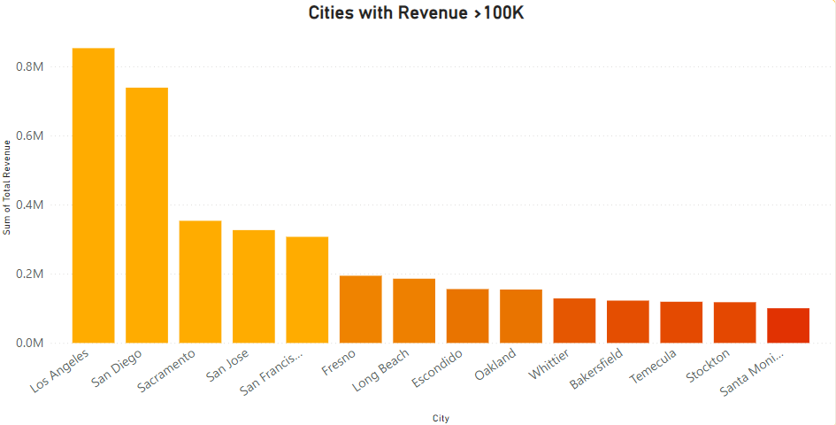
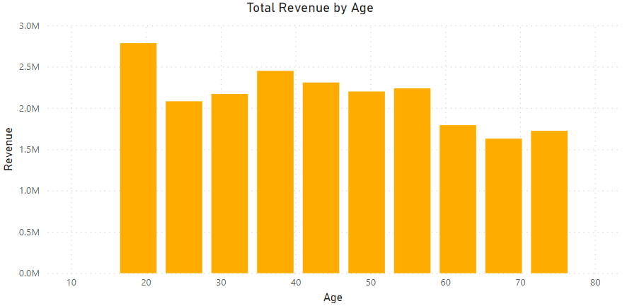
Drivers of Revenue- Location & Age
Location is one of the most prominent factors of growth, with 20% of total revenue being generated from just 14 cities
Coastal areas take up 10/14 cities listed, making it a considerable factor when choosing expansion projects
Majority of revenue is generated by younger customers, with 30% of revenue being from those between 20-30 years old
Appealing to a younger audience is crucial as they are the driving force behind current streaming services

Slide 6
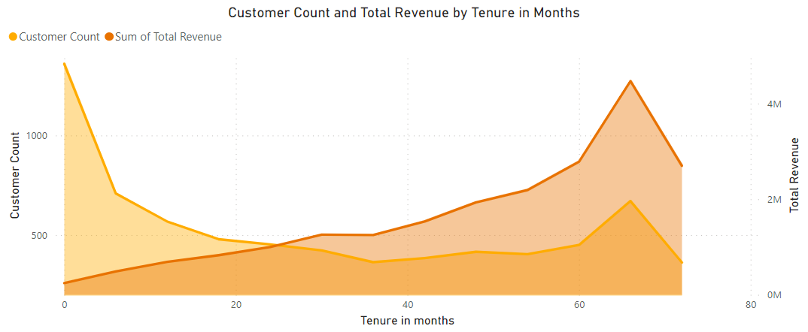
Drivers of Revenue- Tenure
Both tenure and revenue are directly proportionate
However, majority of customers have stayed with the brand for less than a year
Customer loyalty is more consistent after the 24-month mark, with lesser volatility observed and increasing revenue from the 20-60 groups

Slide 7
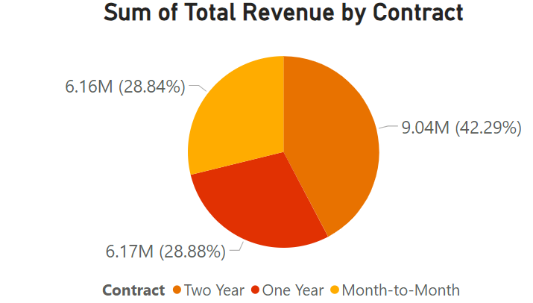
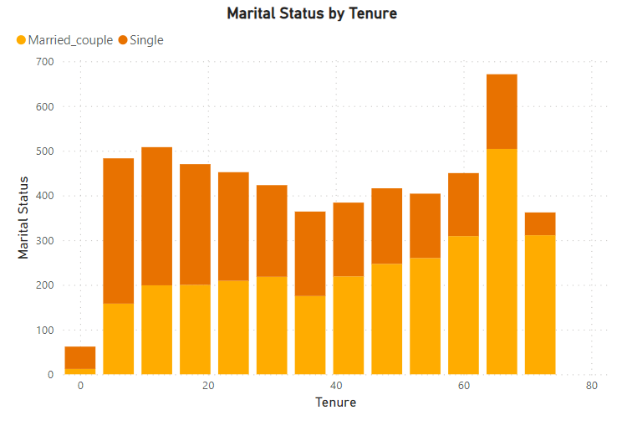
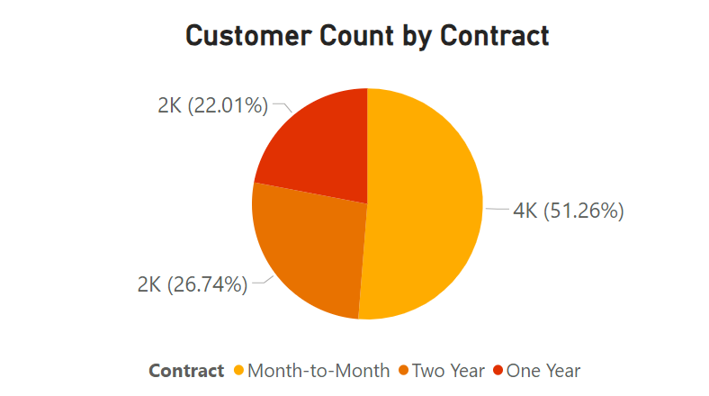
Drivers of Revenue- Contract Type
Although the contract that generated the most revenue is the two-year option, majority of the customers opt for month-to-month
Married couples are more likely to continue in the long run and opt for 2-year contracts, therefore generating more accumulated revenue

Slide 8
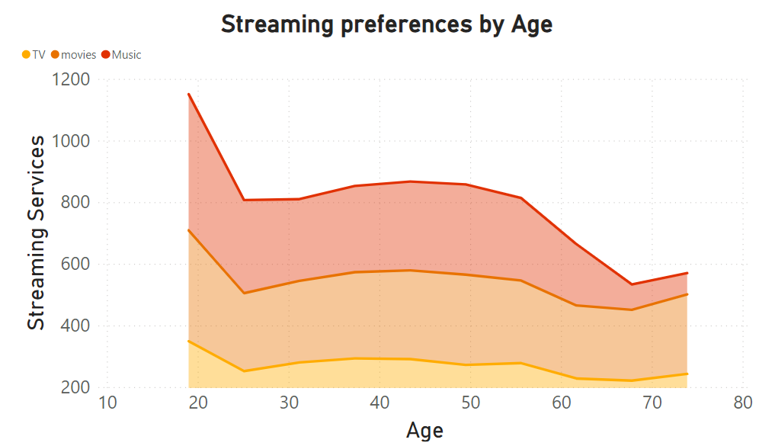
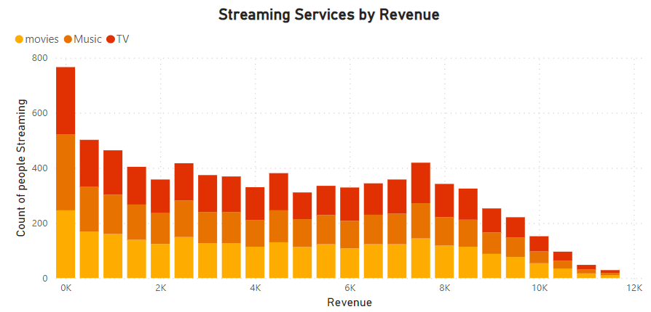
Drivers of Revenue- Streaming Services
The total revenue generated by Streaming services is $8.85 million, which accounts for >40% of the total revenue generated in the last Quarter
The distribution of revenue and number of customers between the 3 streaming services offered (TV, Movies and Music) is nearly identical
Customers below the age of 30 are the highest consumers of streaming services (the target audience), followed by those between 35-60 and then >60 years old

Slide 9
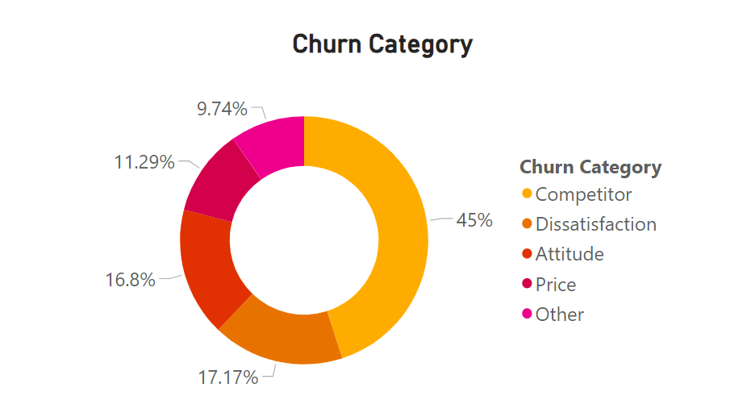
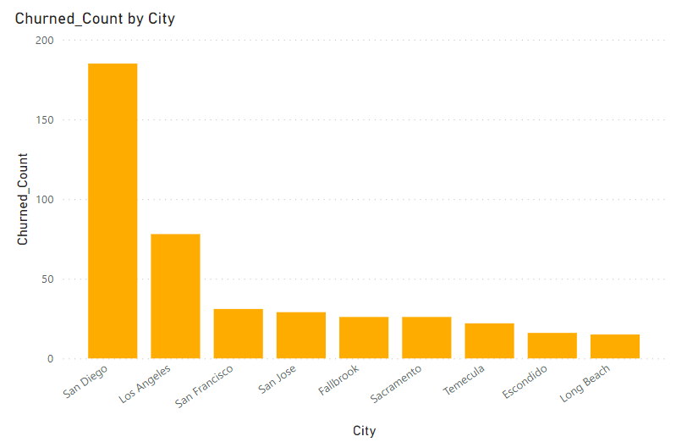
Churned Customers
Close to 27% of the customers in the last quarter have churned
The revenue generated by churned customers account for 17% of overall revenue along with $3000 worth of refunds given to them
Most common reason for churning is that the Competitor had made better devices or offered better services
San Diego has an abnormally large number of churned customer

Slide 10
Recommendations & Conclusion
The analysis conducted indicates that the company needs to make customer retention its top priority. This reduces the probability of customers churning and increase accumulated revenue over time.
In an ideal scenario, the company needs to ensure that customers stay beyond the 24-month mark since they are more likely to generate revenue and stay with the company.
Some ways to increase customer retention is:
Faster response: Quicker replies to queries raised ensure customer satisfaction
Personalised experience: Based on customer demographics, the company can market the services in different languages and provide offers on cultural festivals.
Streamlined customer support services: Ensure that all the customer feedback and complaints are processed in real time to gain better knowledge of underlying issues.
Market and Competitor Research: Majority of customers left the company due to better services and devices offered by competitors. Therefore, doing additional research on the competitors and the current telecom market can ensure where the company is lacking in terms of performance and pricing.

Slide 11
Thank you
By: Vishnu Vardhan

